Slide 1
Stawell Landfill
Community Reference Group
17.3.2022

Slide 2
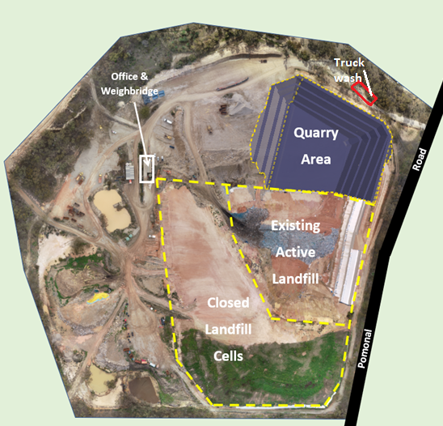
Project Overview, Progress & Site Plan
Cleanaway have commenced quarrying for the next cell at Stawell Landfill.
Works include:
  Drill, Blast, Load & Haul of approx. 160,000 m³ of rock from the future landfill cell footprint;
  Drill and Blast program is almost finalised and will be moving into cell 5 construction phase in April – May 2022;
  Rock crushing will continue till end of May 2022 at the lower level of cell 5 area;
  Hard stand construction completed - early March;
  Completed blast 9 in February 2022. We believe blasting program is completed, will assess if further blasts are required and communicate via email & letter drop.

Slide 3
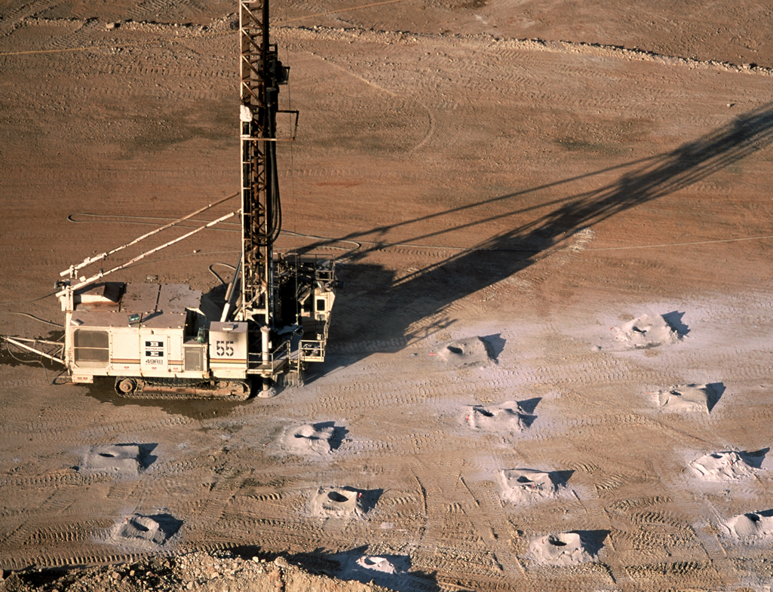
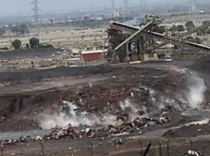
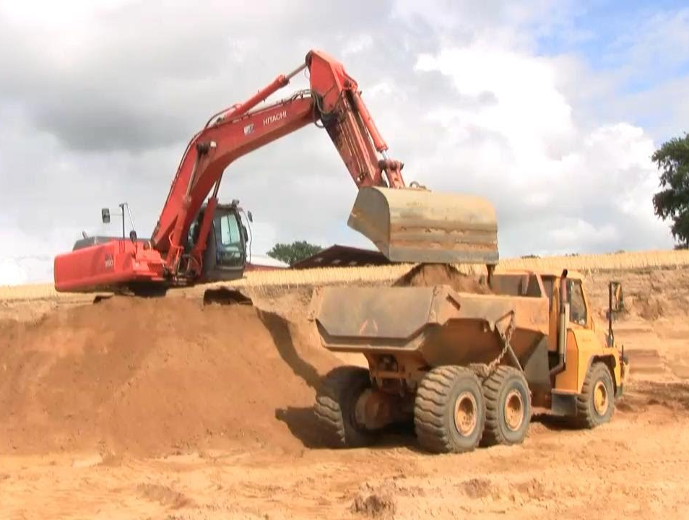
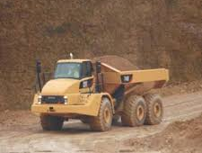
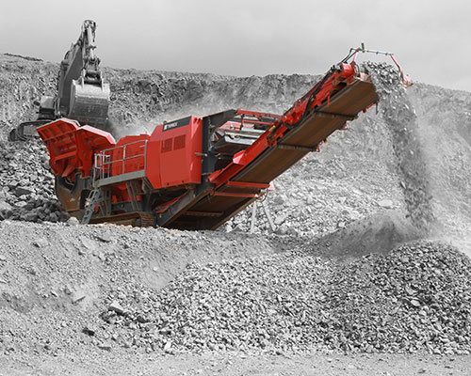
What’s involved in the Drill and Blast works
Drilling | Blasting | Load | Haul | Rock Crushing
Mobilise drill rig to site Set out of drill pattern Drill hole to required depth | Explosives placed in pre-drilled holes Area is evacuated Explosives are detonated | Excavator is used to load blast rock into trucks | Trucks carry blasted material to stockpile location | Blast rock is fed through special crushing machinery to produce crushed rock products
Note: Images sourced from Google and shown for illustrative purposes only. Actual plant used onsite may be different to images shown.

Slide 4
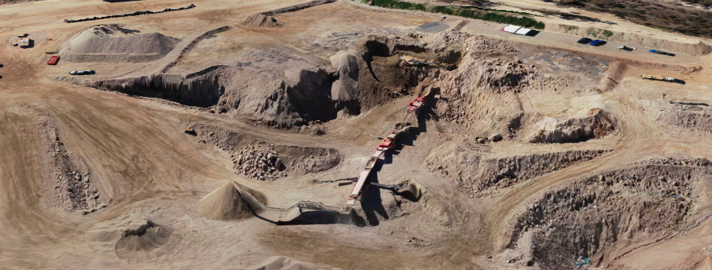
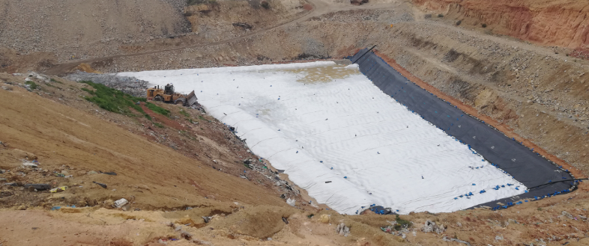
What’s involved in the cell construction works
Quarry | Lining | QA/QC | Waste acceptance
Drill and Blast Removal of rock, crushing etc. | Protection soils and liner material to be placed to prevent contamination. | Quality assurance throughout entire process of cell construction. Conducted by a third party. | QA/QC is finalized, EPA approval to accept waste.

Slide 5
Project Timeline
There is 2 rock crushing items? I thought rock crushing was being completed earlier based on our conversation yesterday? Do we need to add works in clay pit for what Mat mentioned yesterday to prepare Gilda for works in clay pit?
Task | Key Date | 2021 |  |  |  |  |  | 2022
 |  | July | Aug | Sept | Oct | Nov | Dec | Jan | Feb | Mar | Apr | May | Jun | July | Aug
Contractor Mobilisation | Completed July 2021
Load & Haul | From 26/7/21
Drill & Blast | From 2/9/21
Rock Crushing | From 26/7/21
Expected Quarry Completion Date | End of January 2022
Expected Rock Crushing Completion Date | End of April 2022
New Cell Construction | Follows Quarry Completion
✓
✓
✓

Slide 6
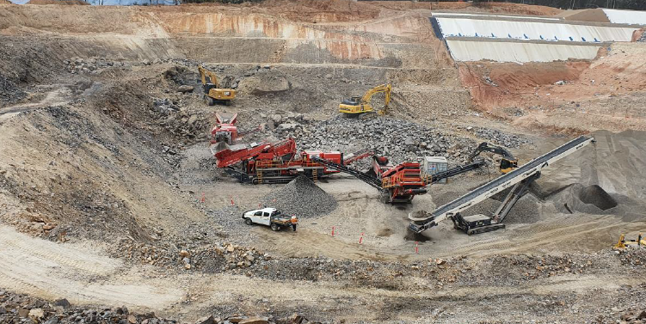
Environmental Management
Vibrations | Rock Crushing
Vibration monitoring have been undertaken during all blasting activities. All blasting monitoring is within the limit set by Earth Resources and Regulation (ERR) | Rock crushing is undertaken on the lower level of the cell to minimise noise impacts. During last 6 months rock crusher has not been used continually to reduce noise impacts.

Slide 7
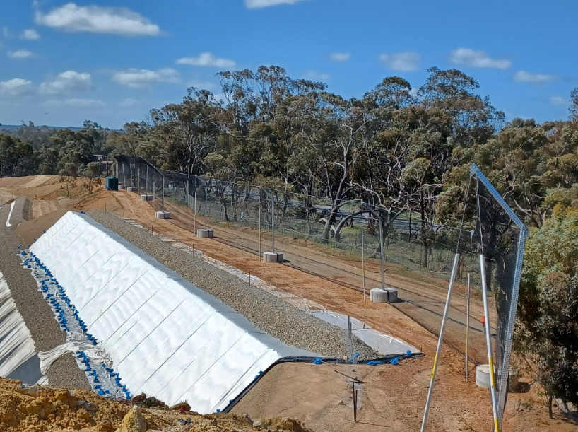
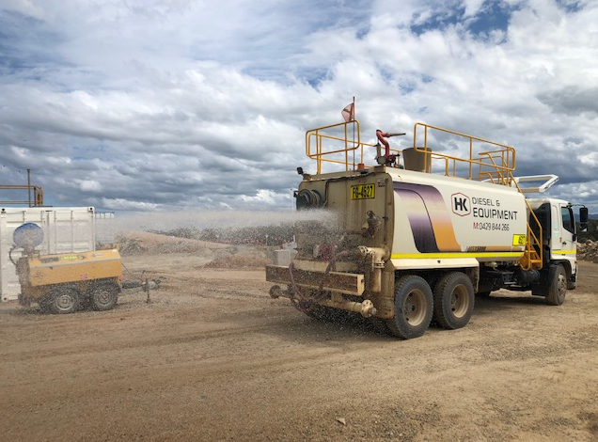
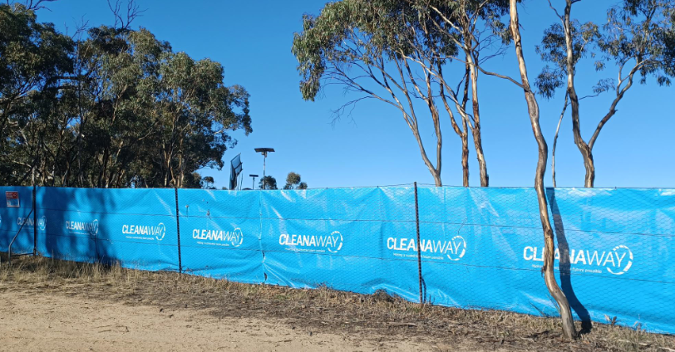
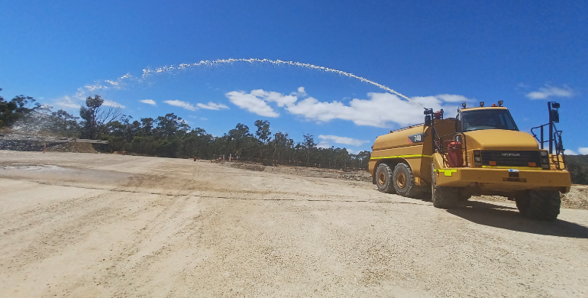
Litter | Dust
6m litter net was installed in October 2021 on eastern side of the site to control wind blown litter on to Pomonal Road, to increase protection for any litter that might escape the existing fence. New Cleanaway net installed in February on the front fence to reduce visual impacts and to stop litter from leaving site (as second line of defense). | Dust impacts are regularly assessed (visual monitoring). Old water was 8000L capacity, newer and bigger water cart (25,000 L) onsite for continual dust suppression. New water truck with water canon for dust suppression on stockpiles.

Slide 8
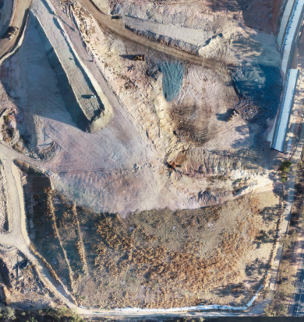
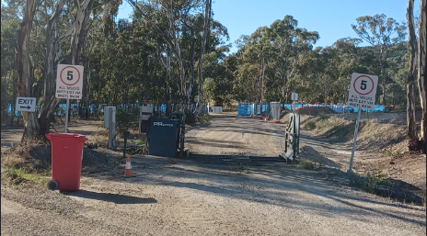
Odour | Truck wash
All odorous load will undergo deep burial as per the best practice guideline to minimise odour impacts. End of each day, waste will be covered with clay or alternate daily cover approved by EPA to eliminate odour impacts. | All incoming trucks with waste have to exit through truck wash to minimise soil and gravel being tracked to main road.

Slide 9
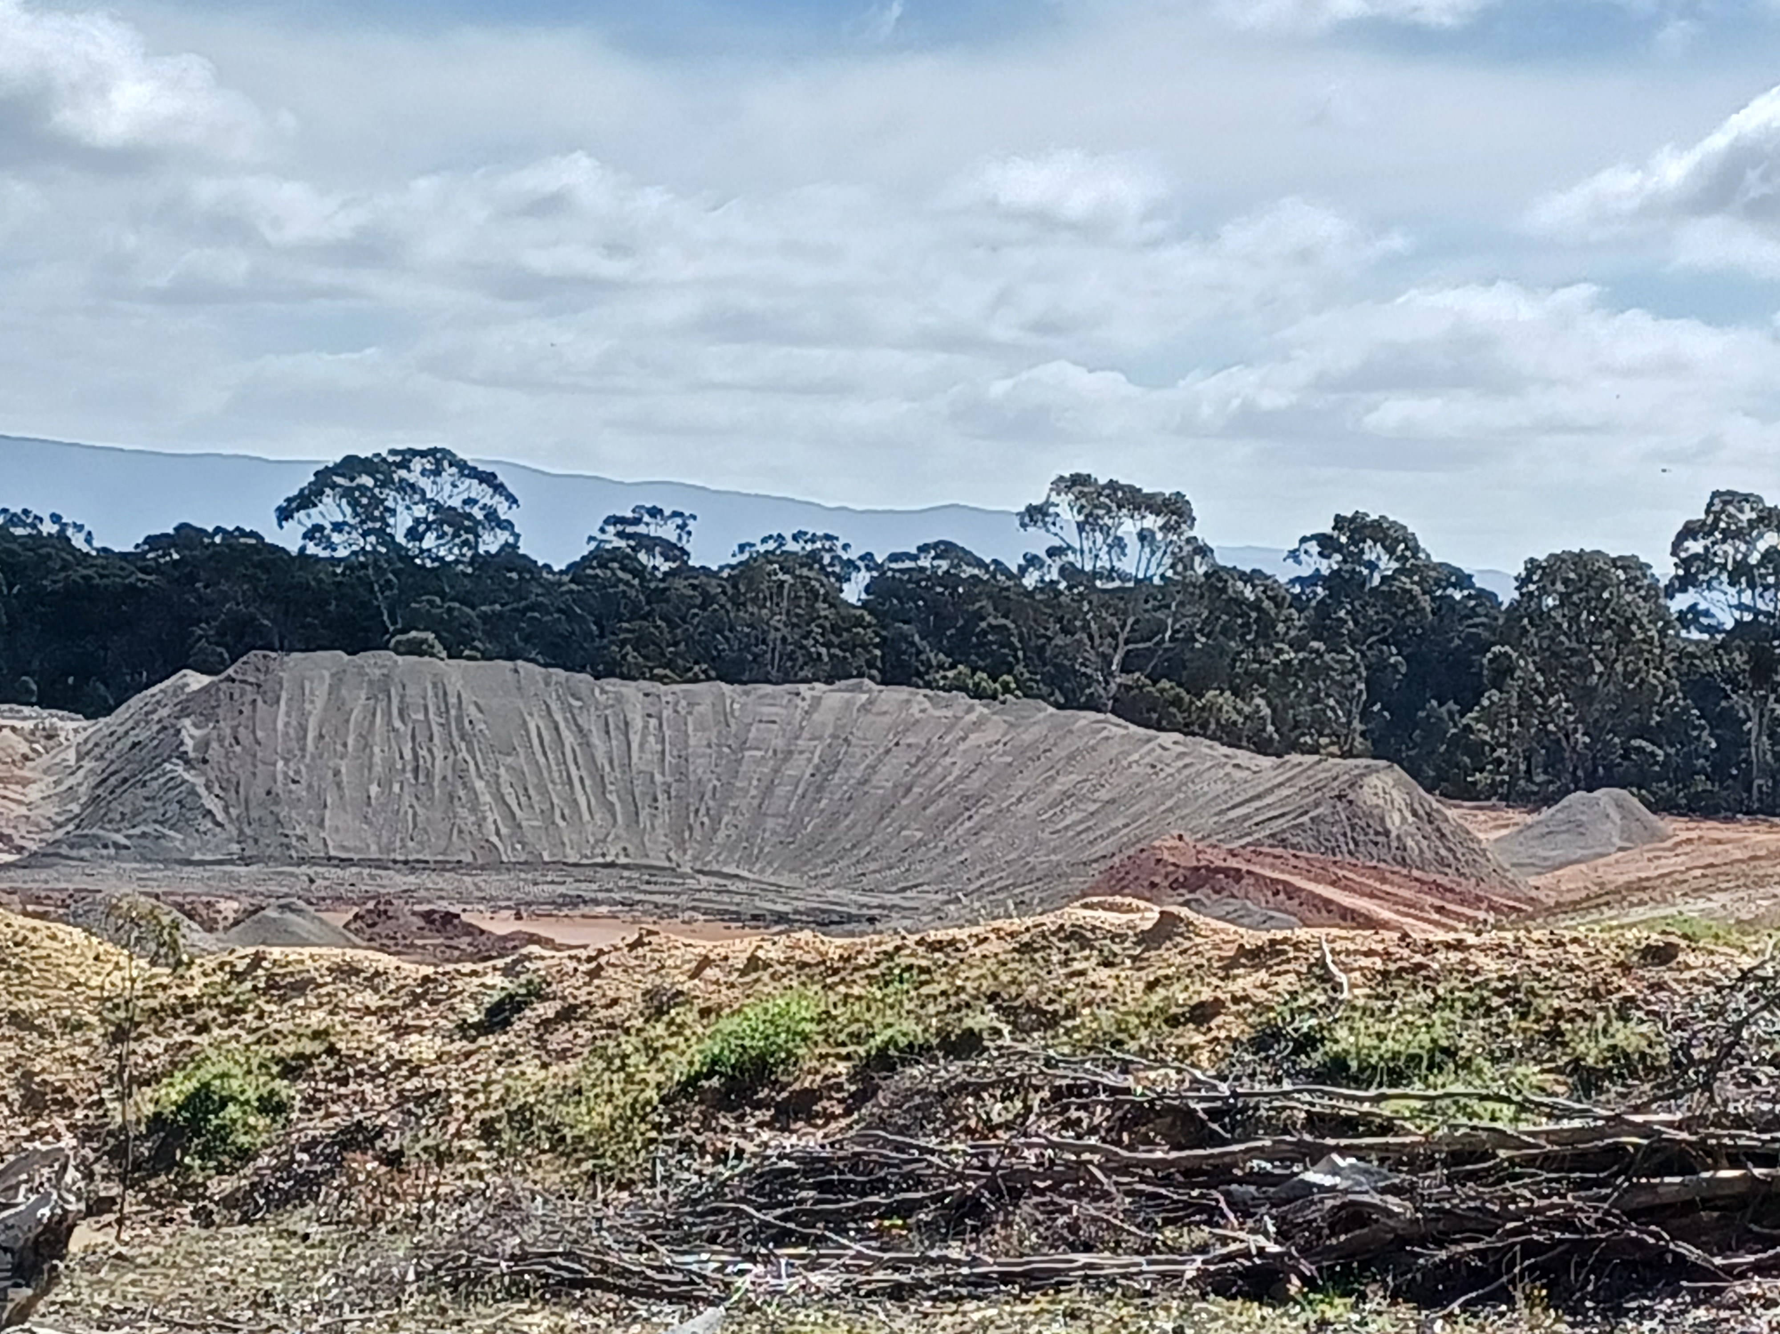
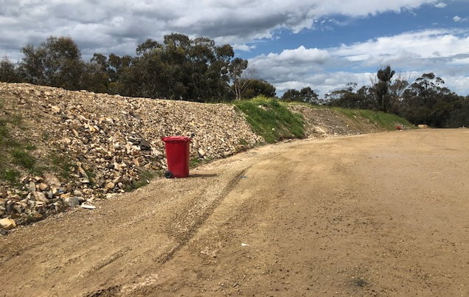
Noise
Noise bunds around the site has been extended to minimize noise from quarry, crushing, hauling and landfill activities. Following a noise complaint for the works in clay pit area, a new noise bund has been constructed in clay pit area and the noisy dozer has been replaced with newer and quieter one. Cleanaway has installed broadband reverse beepers on all the equipment on site to minimise noise. Contractors on site will undertake regular noise monitoring for blasting activity, all blasting activity is within the limit set by Earth Resource and Regulation (ERR) Works onsite is within the approved hours of operation (7:30 am – 5:30 pm Mon to Fri, 9:30 – 2:30pm Sat, Closed on Sundays). We can operate for 2 hours from 10-2pm on Public Holidays (PH). Have contacted Council and have gained approval to open an extra hours during PH till June 2022, to serve local community.

Slide 10
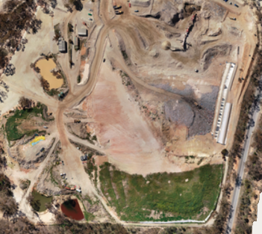
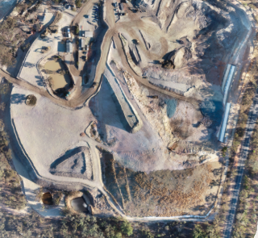
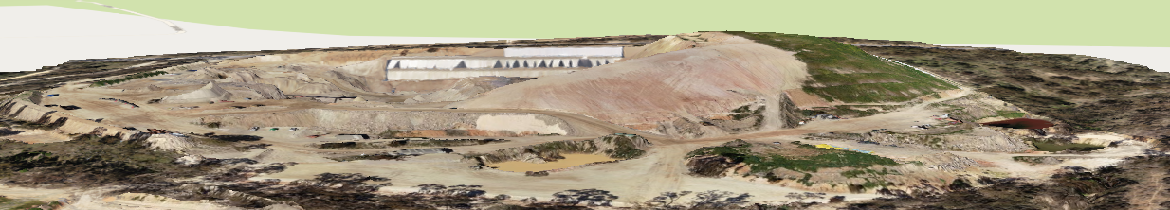
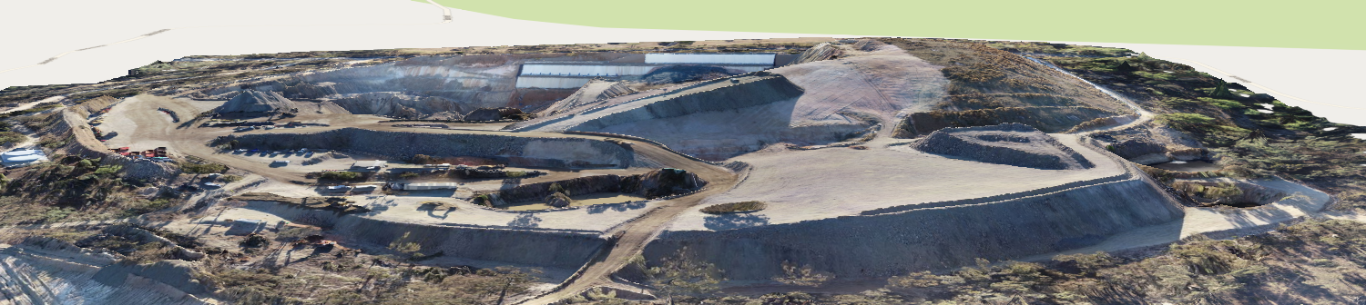
Noise – Hard stand construction
Quarry rock is been used to create hard stand areas around the site to create more operating area and also to cap asbestos and shredded tyre cells. Hard stand construction completed in early March 2022. Before - Sept 2021 After – March 2022

Slide 11
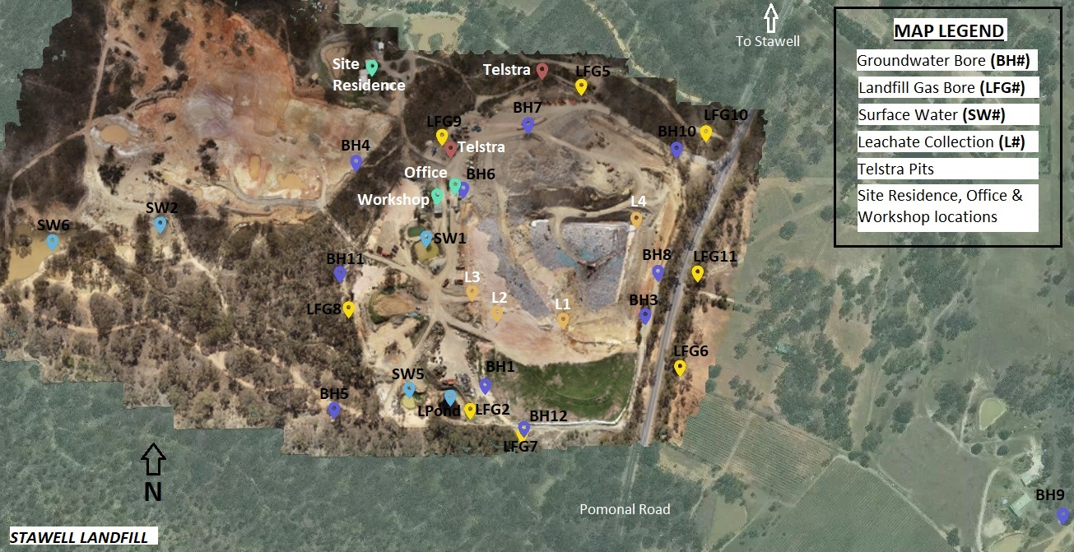
Management of Stormwater and Leachate Collection System
Surface run off is captured in series of storm water dams and reused onsite for dust suppression. Leachate from completed and active cells are pumped into the leachate dam and is regularly monitored to maintain safe freeboard. Contingency plan in place to dispose leachate to the authorized place if required. New leachate pond construction will start soon. Quarterly surface and ground water, leachate, gas monitoring is undertaken to ensure no environmental impact from landfill operation and monitoring report are submitted to EPA.

Slide 12
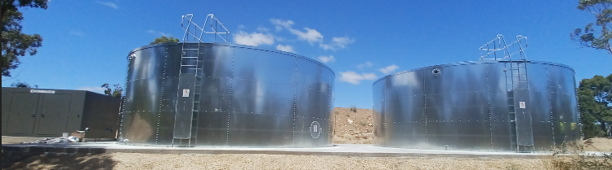
IMPROVEMENT AROUND THE SITE
We have gone from 40,000 L static supply to 256,000 L (pump set can pump 3000 L/min) for increased fire fighting capabilities in the event of a bushfire or landfill fire.

Slide 13
Ongoing Communications
Cleanaway will continue to provide updates to the community about the site regularly through emails, letter drops and newsletter.
6 monthly newsletter will be issued in June 2022.
Have completed 9 blasts till date and will assess if further blasts are required. It will be communicated via email & letter drop.
We appreciate your feedback and please contact us if you have any issues or if you require further clarification about our operation.

Slide 14
Questions?

