Slide 1
Stawell Landfill
Community Reference Group
27.9.2022

Slide 2
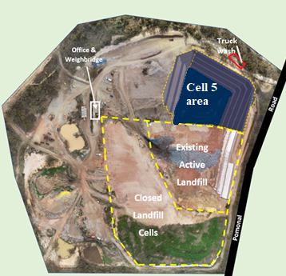
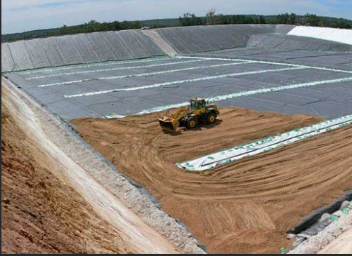
Project Overview, Progress & Site Plan
Cleanaway have commenced cell 5 construction at Stawell Landfill in line with EPA approved design.
Works include:
  Placing 50:50 clay mix as initial protection layer;
  HDPE liner and geomembrane layer placement to prevent groundwater contamination;
  Cell 5
    phase 1 (till stage 3) will be completed by March 2023 and
    phase 2 (stage 4 and 5) will be completed in May 2023
  As built details will then be reviewed by the EPA appointed auditor and report will be submitted to EPA for approval.
  Once EPA is happy with construction details, EPA will issue approval for waste disposal via EPA licence amendment;

Slide 3
Planning Permit amendment – Stawell Landfill
Cleanaway can operate for 2 hours from 10-2pm on Public Holidays (PH) and Sundays. Historically Statewide recycling and Cleanaway has been requesting Norther Grampians Shire Council (NGS Council) till June 2022 for extra 1.5 hours on public holidays for landfilling activities and has been approved. NGS Council requested we formally change our planning permit so we commenced the process to change our hours on PHs only. Cleanaway applied for planning permit amendment to operate for extra 1.5 hours on only public holidays only to accommodate trucks coming from other shires, to allow time for compaction and for daily cover. Cleanaway is awaiting approval for this change as it is necessary for the waste collection trucks to be able to collect residential rubbish on PHs. Cleanaway is not proposing to increase operating hours on Sundays in the permit amendment.

Slide 4
Environmental Management
Noise
Noise bunds around the site has been extended and improved to minimize noise from quarry, crushing, hauling and landfill activities. Earth Resources and Regulation (ERR) issued Section 110 Notice to undertake noise monitoring at 2 residences. External consultant was engaged to conduct noise monitoring, and the report was submitted to ERR, Northern Grampians Shire Council and EPA as per notice requirements. Noise monitoring was conducted for 2 work authorities - WA 614 quarry and landfilling area and WA1450 clay pit area. WA614 noise monitoring was conducted between 18th May 2022 and 14th June 2022 WA1450 was conducted between 27th May 2022 and 21st June 2022 Assessment for both work authorities showed that noise from Stawell landfill complied with EPA noise protocol.

Slide 5
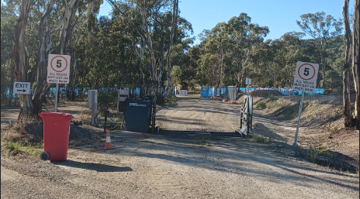
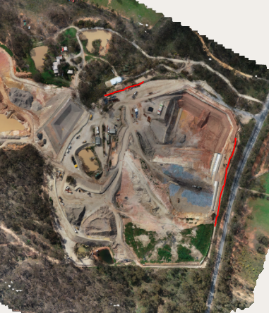
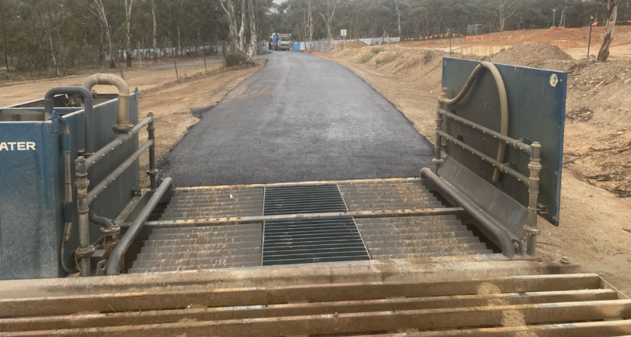
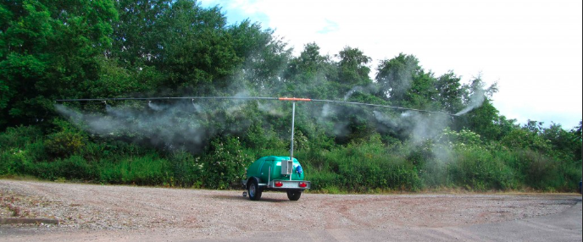
Odour | Truck wash and security around the site
Admin controls is in place to monitor wind direction and manage potential high odourous activities. All odorous load will undergo deep burial as per the best practice guideline to minimise odour impacts. End of each day, waste will be covered with alternate daily cover approved by EPA to eliminate odour impacts. ADC is used daily and double cover on end of week and during long weekends. Odour curtains will be installed by end of October 2022 along Pomonal road and northwestern corner of the active cell to minimise odour impacts to nearest receptors. Landfill gas extraction system is under construction. It will be competed early next year. This will help minimizing odour impacts from landfill gas. | All incoming trucks with waste must exit through mandatory truck wash to minimise soil and gravel being tracked to main road. Security cameras have been recently upgraded throughout the site. One near the entry and rest around the site.

Slide 6
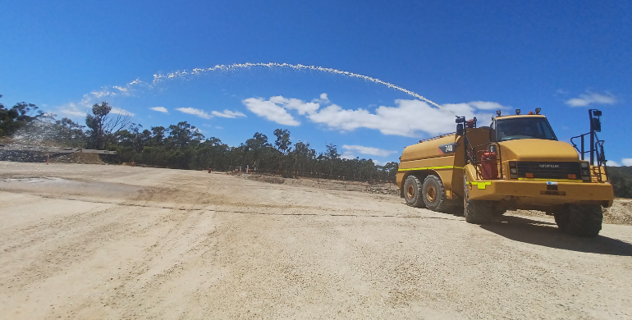
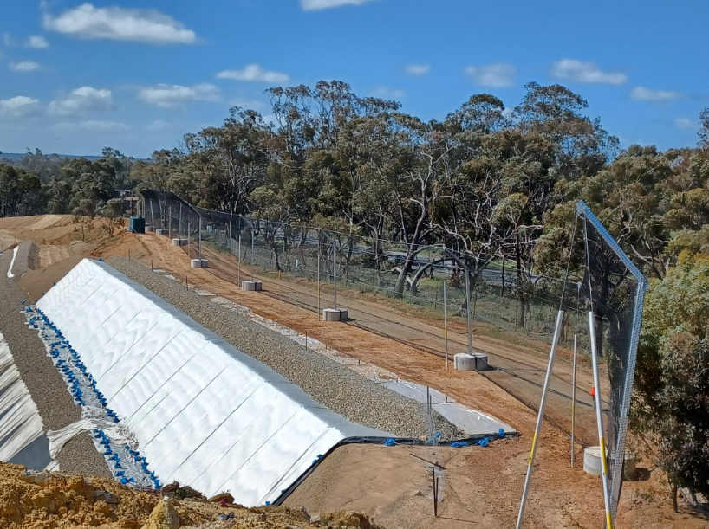
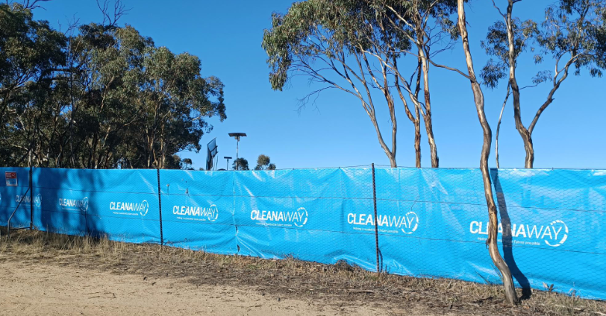
Litter | Dust and Fire management
6m litter net was installed in October 2021 on eastern side of the site to control wind blown litter on to Pomonal Road, to increase protection for any litter that might escape the existing fence. New Cleanaway net installed in February on the front fence to reduce visual impacts and to stop litter from leaving site (as second line of defense). Daily litter patrol happens to pick up any wind-blown litter from the trucks or the site and is recorded in the daily report. | New water truck with water canon is used for dust suppression and fire fighting purposes. This will help us manage tip face fires and bushfire management to keep the community safe. Cleanaway is in contact with CFA to use our new truck for fire fighting purposes in case of bushfire emergency around the region.

Slide 7
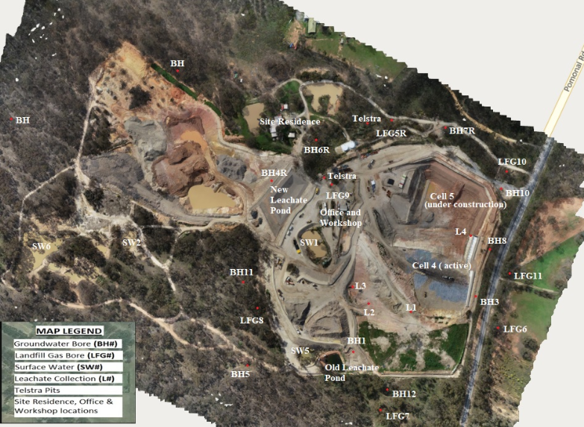
Management of Stormwater onsite
Surface run off is captured in series of storm water dams and reused onsite for dust suppression. Quarterly landfill gas and surface emission monitoring and 6 monthly surface and groundwater monitoring is undertaken to ensure no environmental impact from landfill operation. All monitoring reports are verified by EPA appointed auditors and submitted to EPA every 2 years.

Slide 8
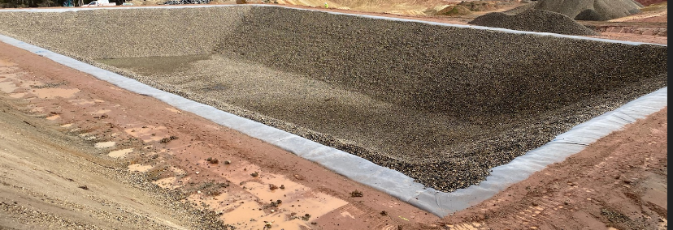
Management of Leachate Collection System
Cleanaway has spent approx. $400K for a new leachate dam. This is a bigger dam and is constructed as per Best Practice Environmental Management requirement. This dam can collect leachate generated from closed cell 1, inactive cell 2 and 3, active cell 4, future cells 5 and 6. Cleanaway has received temporary approval from EPA early September 2022, to store leachate from the cells into new leachate pond to minimise potential pollution from wet weather event .

Slide 9
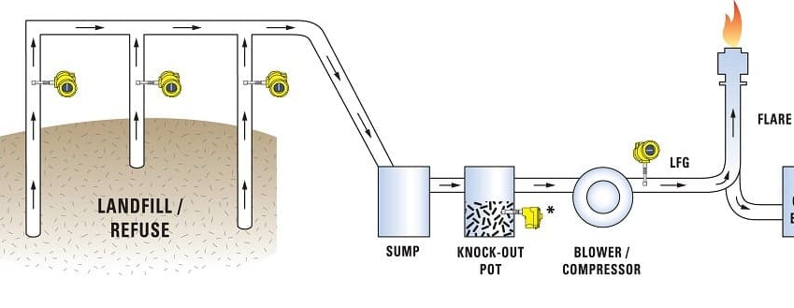
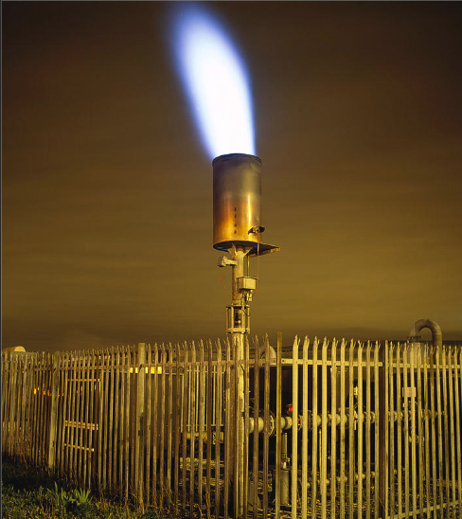
Landfill Gas Extraction
External contractor is undertaking landfill gas extraction project in Stawell Landfill. Gas well drilled into the closed and inactive cells and will be connected to Flare. This will help in managing landfill gas odour impacts along Pomonal road. Flare is primarily used for combusting excess landfill gas (methane) generated by the landfill cells. This project will be completed early 2023.

Slide 10
Ongoing Communications
Cleanaway will continue to provide updates to the community about the site regularly through emails, letter drops and newsletter.
6 monthly newsletter will be issued in Dec 2022.
We appreciate your feedback and please contact us if you have any issues or if you require further clarification about our operation.

Slide 11
Questions?

